Slide 1
Comparison Methods 2 Internal and External Rates of Return
APSC 221 – Week 3
Summer 2024

Slide 2
Which of these sounds more impressive/relatable:
This investment has a present value $10; or
This investment has a return of 50%?

Slide 3
Internal Rate of Return
Underlying this question is: What is the required profit?
The (relative) return of an investment in a project is known as the internal rate of return.
Definition
The IRR is the interest rate that makes both the PW and AW equal zero.
The IRR is based only on the project’s cash flow; not other things.
For the IRR to exist, both the benefits and costs must be defined.
Notes:
Ultimately, the present worth is absolute, while an IRR is relative.
Investments are taken with the underlying expectation of a return in the form of future earnings. This is the MARR. Look at the relative return as the MARR would be the “do nothing” option.

Slide 4
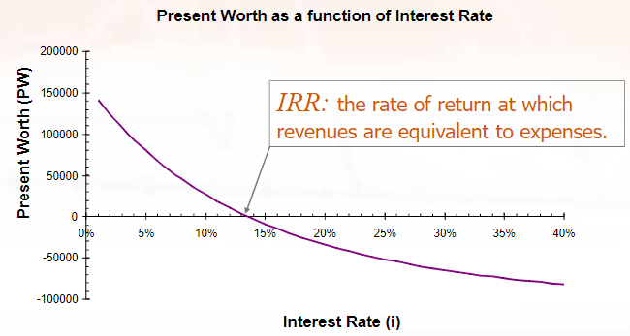

Calculating Internal Rate of Return
Determine the interest rate, $i^{∗}$, such that the PW of the cash flows is zero.
$$PW=0=\sum_{t=0}^{T}{\frac{R_{t}−D_{t}}{{\left(1+i^{∗}\right)}^{t}}}$$
Notes:
In other words, the present worth of inflows equals the present worth of outflows.
IRR is usually positive. Negative IRR means that the project is losing money. Determine this by trial-and-error or through built-in functions.

Slide 5
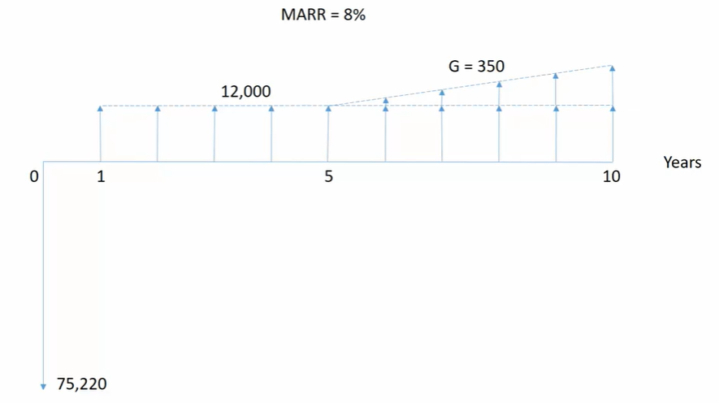
Example - IRR

Slide 6
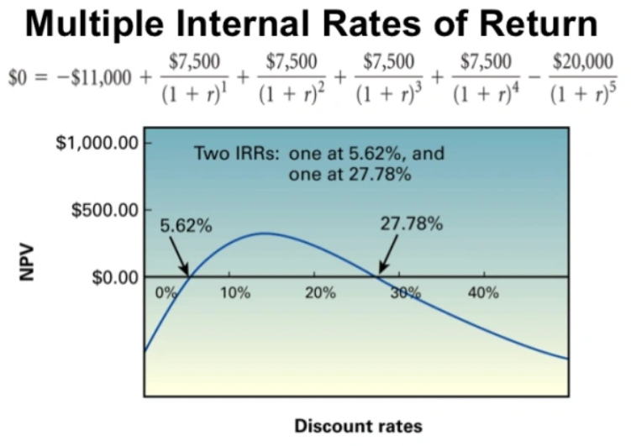

Calculating Internal Rate of Return
Can you see an issue with getting a solution for this equation?
$$PW=0=\sum_{t=0}^{T}{\frac{R_{t}−D_{t}}{{\left(1+i^{∗}\right)}^{t}}}$$
Notes:
Requires only 1 sign change in the cash flows to get 1 solution. Multiple cash flow vector changes lead to no solution or multiple solutions.

Slide 7
Required Assumptions
To determine an IRR, the following assumptions are required for the method:
Cash flows are known with certainty.
Cash flows occur at the end of each period of 1 through N.
Both positive and negative cash flows must be present in the analysis; and
The sequence of cash flows can have only 1 sign change between positive and negative cash flows.

Slide 8

Evaluation Criteria
Independent Projects
Select any project where the IRR > MARR
Mutually Exclusive Projects
Select the highest IRR?
It is important to determine if each incremental investment earns at least the MARR
Highest IRR is not as simple to determine

Slide 9
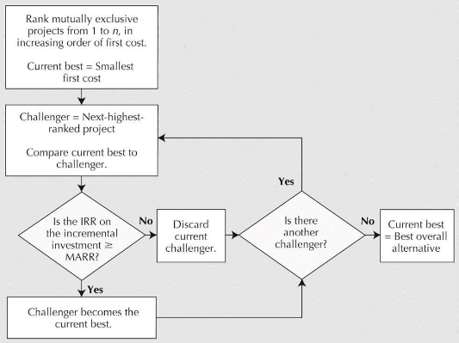
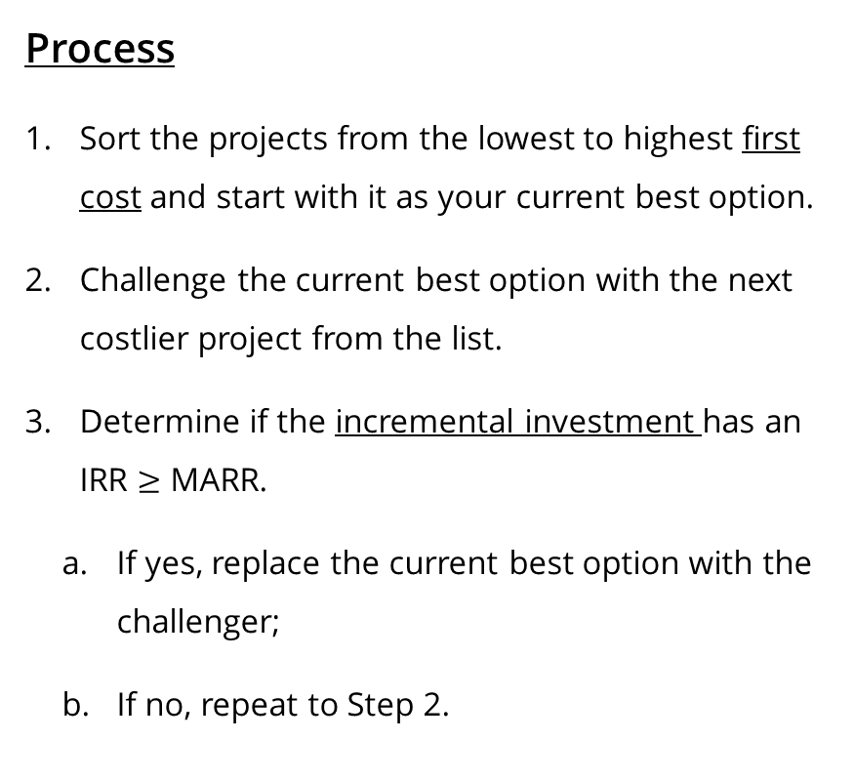
IRR for Mutually Exclusive Projects
Process
Sort the projects from the lowest to highest first cost and start with it as your current best option.
Challenge the current best option with the next costlier project from the list.
Determine if the incremental investment has an IRR $≥$ MARR.
If yes, replace the current best option with the challenger;
If no, repeat to Step 2.

Slide 10
Example – Mutually Exclusive IRR
Which option would you choose?
Assuming a MARR of 70%, you could:
Invest $1 today, and receive $2 in a year; or
Invest $1000 today, and receive $1900 in a year.
Notes:
Project 1 -> PW = 0 = -1 + 2 (P/F, i, 1) -> i=100%
Project 2 -> PW = 0 = -1000 + 1900(P/F, i, 1) -> i=90%
Incremental investment -> PW = 0 = -(1000-1) + (1900-2)(P/F, i, 1) -> i=89.9%

Slide 11
Returning to this problem:

Slide 12
External Rate of Return
When we have multiple IRR, we use an external rate of return.
We combine internal and external investments to determine to viability of a complex project. We convert a non-standard cash flow into a standard cash flow by assuming that we can invest cash at the MARR rather than invest it in the project (“do nothing” option).
Approaches
Precise ERR (need a rate of return)
Approximate ERR (just need a decision)

Slide 13
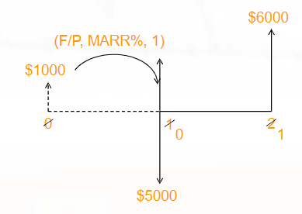
Precise ERR
Convert a non-standard cash flow into a standard cash flow and then conduct the IRR calculation

Slide 14
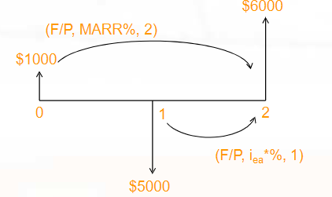

Approximate ERR
Determine an ERR by conducting a $FW=0$ analysis, with cash inflows being discounted at the MARR and cash outflows being discounted at the $ERR_{approx}$

Slide 15
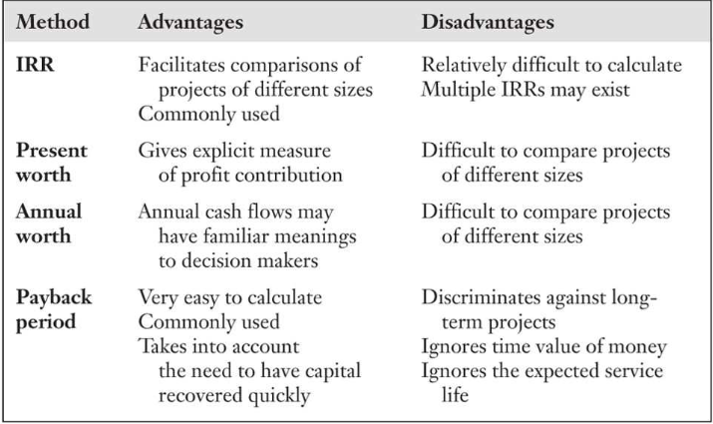
Advantages and Disadvantages of Comparison Methods

